Slide 1
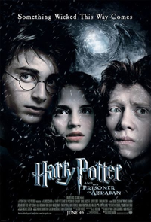
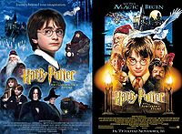
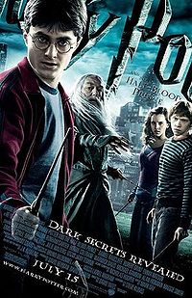

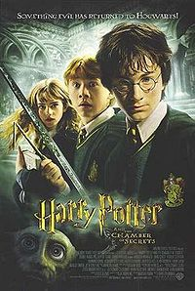
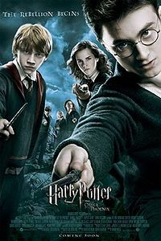
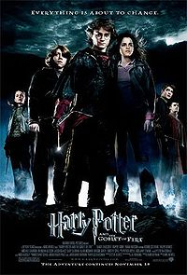

Slide 2

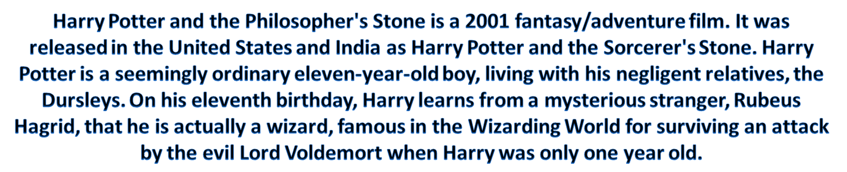
Directed by | Chris Columbus
Produced by | David Heyman
Written by | Screenplay: Steve Kloves Novel: J. K. Rowling
Starring | Daniel Radcliffe Rupert Grint Emma Watson Richard Harris Robbie Coltrane Alan Rickman Maggie Smith Ian Hart
Release date(s) | United Kingdom 4 November 2001 United States 14 November 2001
Running time | 152 minutes

Slide 3

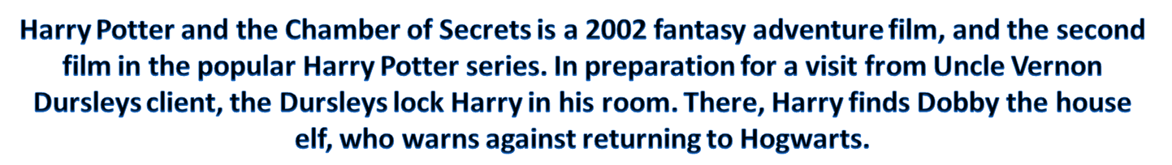
Directed by | Chris Columbus
Produced by | David Heyman
Written by | Screenplay: Steve Kloves Novel: J. K. Rowling
Starring | Daniel Radcliffe Rupert Grint Emma Watson Richard Harris Kenneth Branagh Jason Isaacs Christian Coulson Robbie Coltrane
Release date(s) | 15 November 2002
Running time | 161 minutes

Slide 4

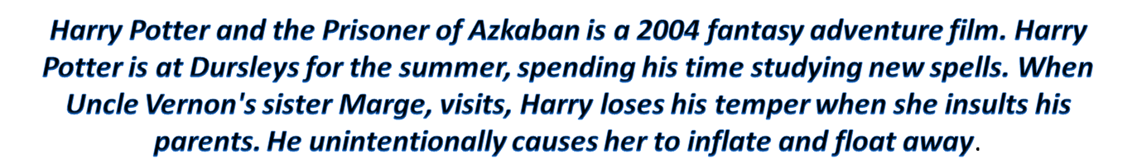
Directed by | Alfonso Cuarón
Produced by | Chris Columbus David Heyman Mark Radcliffe
Written by | Screenplay: Steve Kloves Novel: J. K. Rowling
Starring | Daniel Radcliffe Rupert Grint Emma Watson Michael Gambon Gary Oldman David Thewlis Timothy Spall Emma Thompson
Release date(s) | United Kingdom 31 May 2004 United States 4 June 2004
Running time | 141 minutes

Slide 5

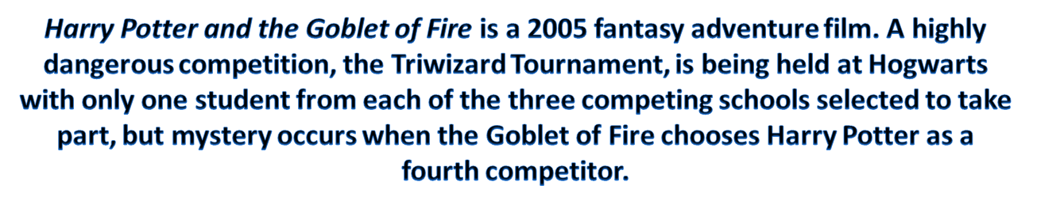
Directed by | Mike Newell
Produced by | David Heyman
Written by | Screenplay: Steve Kloves Novel: J. K. Rowling
Starring | Daniel Radcliffe Rupert Grint Emma Watson Ralph Fiennes Michael Gambon Brendan Gleeson Robert Pattinson Miranda Richardson
Release date(s) | 18 November, 2005
Running time | 157 minutes

Slide 6

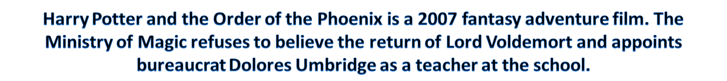
Directed by | David Yates
Produced by | David Heyman David Barron
Written by | Screenplay: Michael Goldenberg Novel: J.K. Rowling
Starring | Daniel Radcliffe Rupert Grint Emma Watson Ralph Fiennes Michael Gambon Imelda Staunton Gary Oldman Helena Bonham Carter
Release date(s) | United States 11 July 2007 United Kingdom 12 July 2007
Running time | 138 minutes

Slide 7

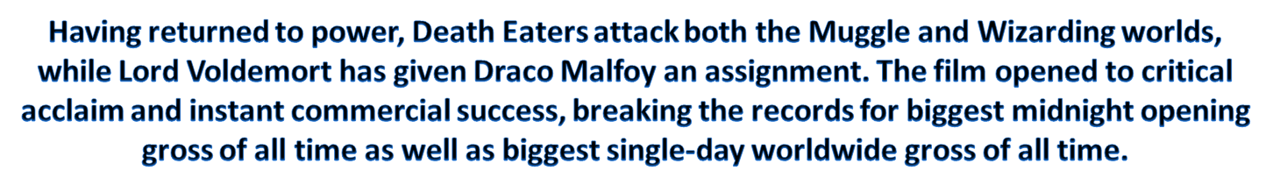
Directed by | David Yates
Produced by | David Heyman David Barron
Written by | Screenplay: Steve Kloves Novel: J. K. Rowling
Starring | Daniel Radcliffe Rupert Grint Emma Watson Michael Gambon Jim Broadbent Alan Rickman Tom Felton Helena Bonham Carter
Release date(s) | 15 July 2009
Running time | 153 minutes

Slide 8

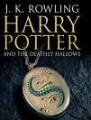
Directed by | David Yates
Produced by | David Heyman David Barron
Written by | Screenplay: Steve Kloves Novel: J. K. Rowling
Starring | Daniel Radcliffe Rupert Grint Emma Watson
Release date(s) | Part I November 19, 2010 Part II July 15, 2011
Running time

Slide 9

